Slide 1


Overview of NAV3 POC
May 2022

Slide 2

NAV3-POC
Why do we need machine learning?
What is the purpose of NAV3-POC?
Research hypothesis
Hypothesis – Dynamic tolerances
Hypothesis – Dynamic tolerances (Code example)
NAV3-POC progress and challenges

Slide 3
NAV3-POC | Why do we need machine learning?
Rules
Traditional Programming
Answers
Data
Answers
Machine Learning
Rules
Data

Slide 4

NAV3-POC | Why do we need machine learning?
Answers
Machine Learning
Rules
Data
Training phase
Model
Data
Predictions
Inference phase

Slide 5
NAV3-POC | Project overview
Data-Driven
Rule-Driven
Human-Driven
Evolution of NAV validation

Slide 6
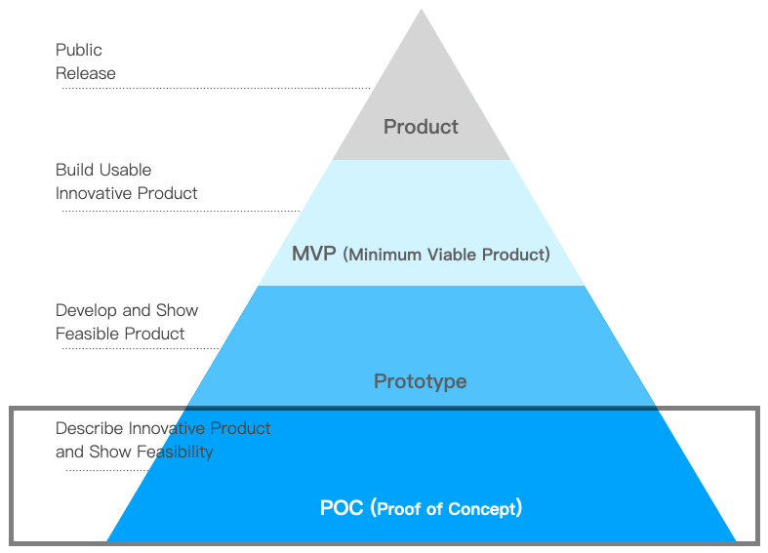
NAV3-POC | Project overview
Data-Driven
Rule-Driven
Human-Driven
Evolution of NAV validation
Product innovation framework

Slide 7
NAV3-POC | Project overview
Goal : Demonstrate and verify the data-driven evolution of NAV validation
Data-Driven
Rule-Driven
Human-Driven
Evolution of NAV validation
Product innovation framework

Slide 8
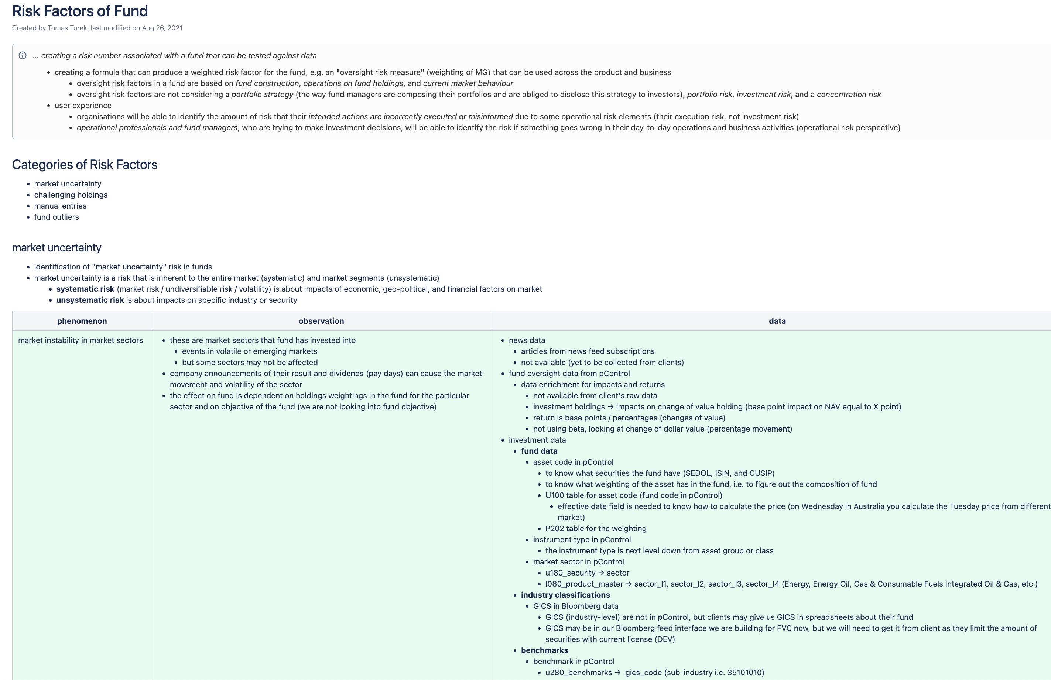
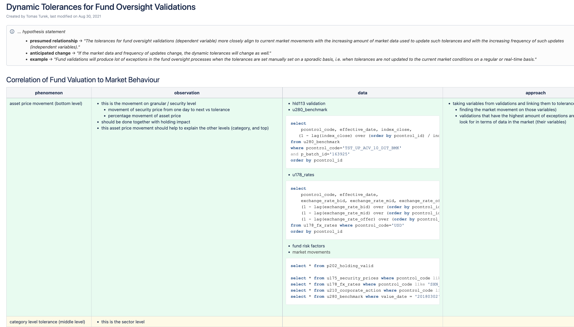
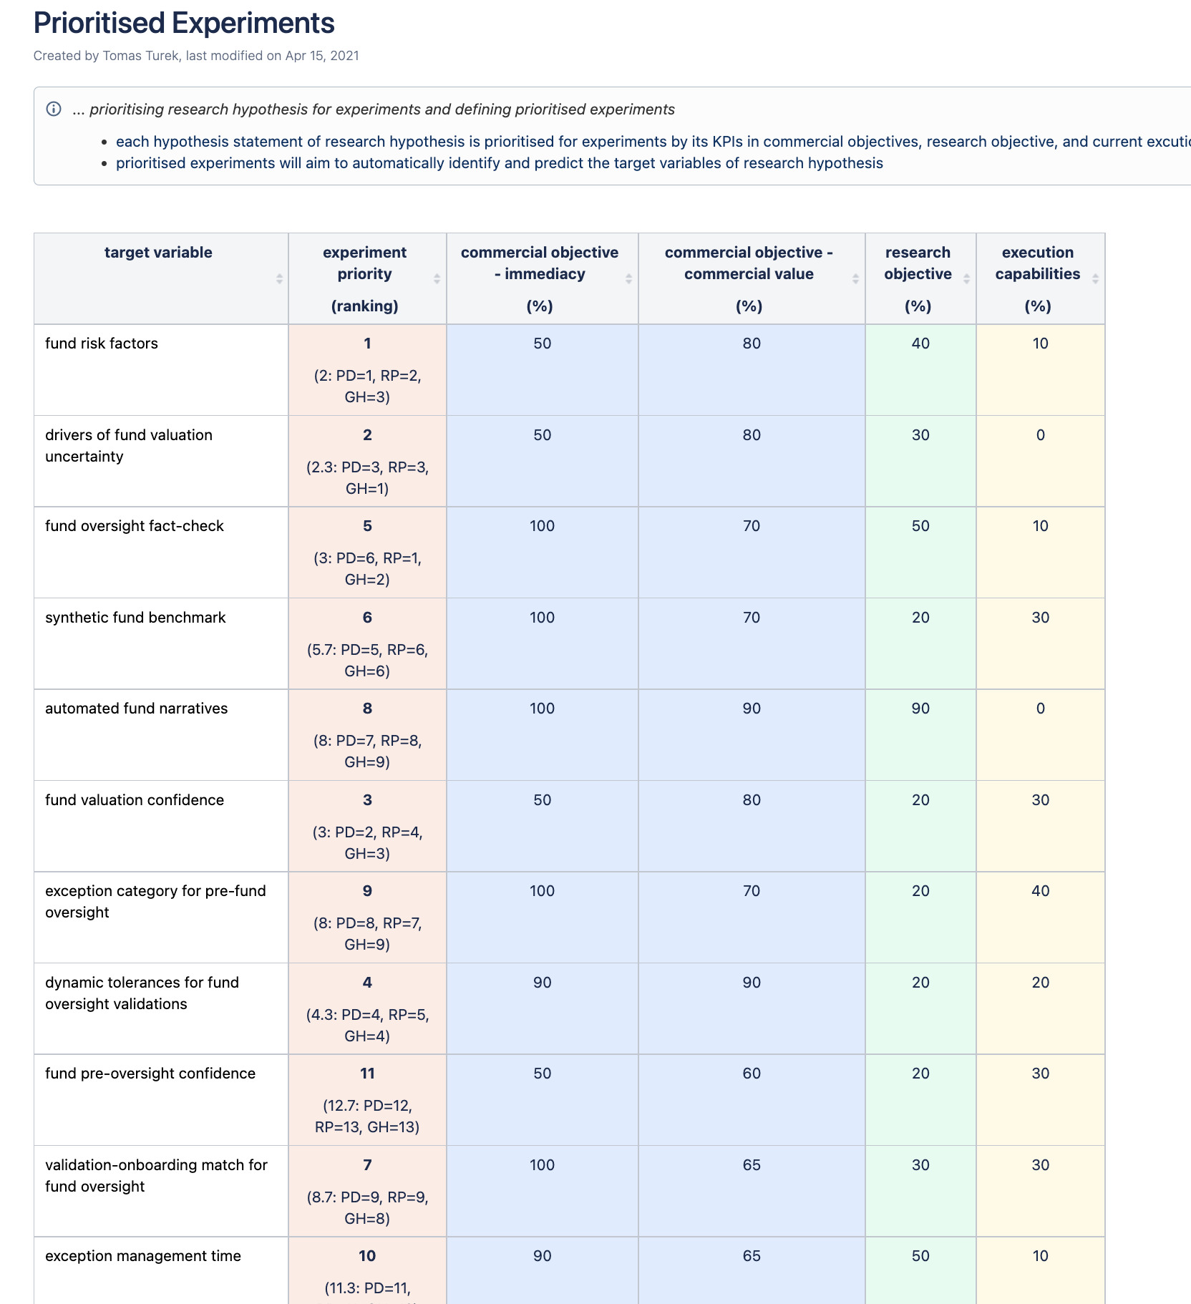
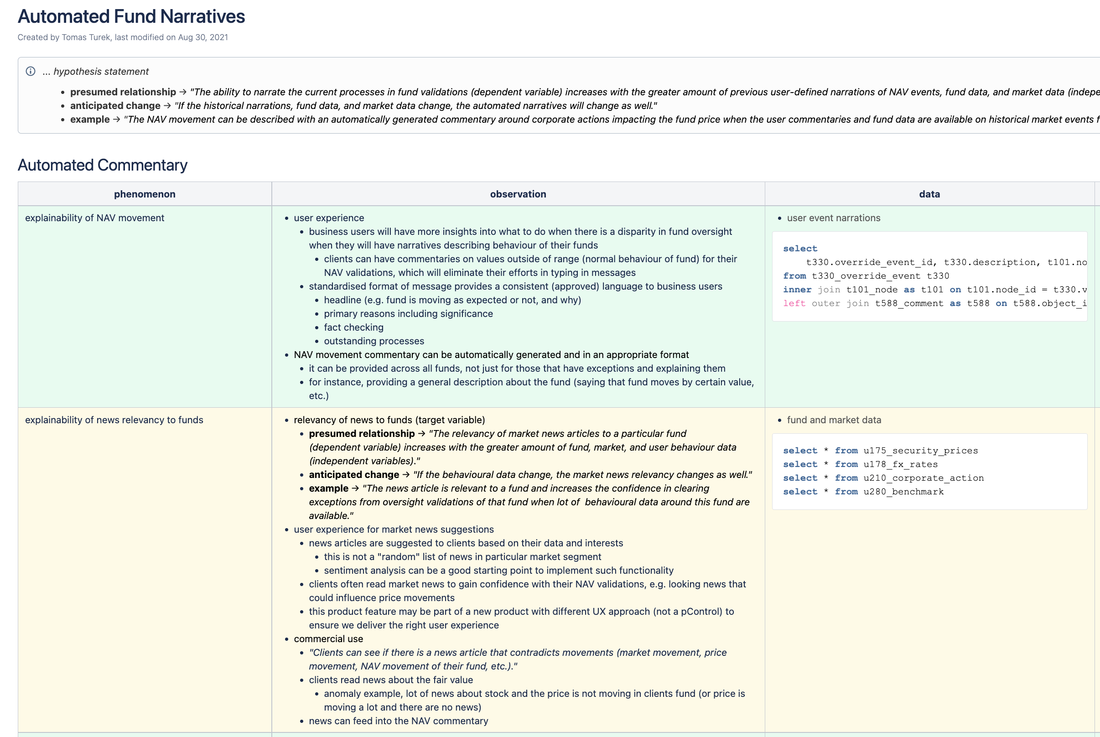
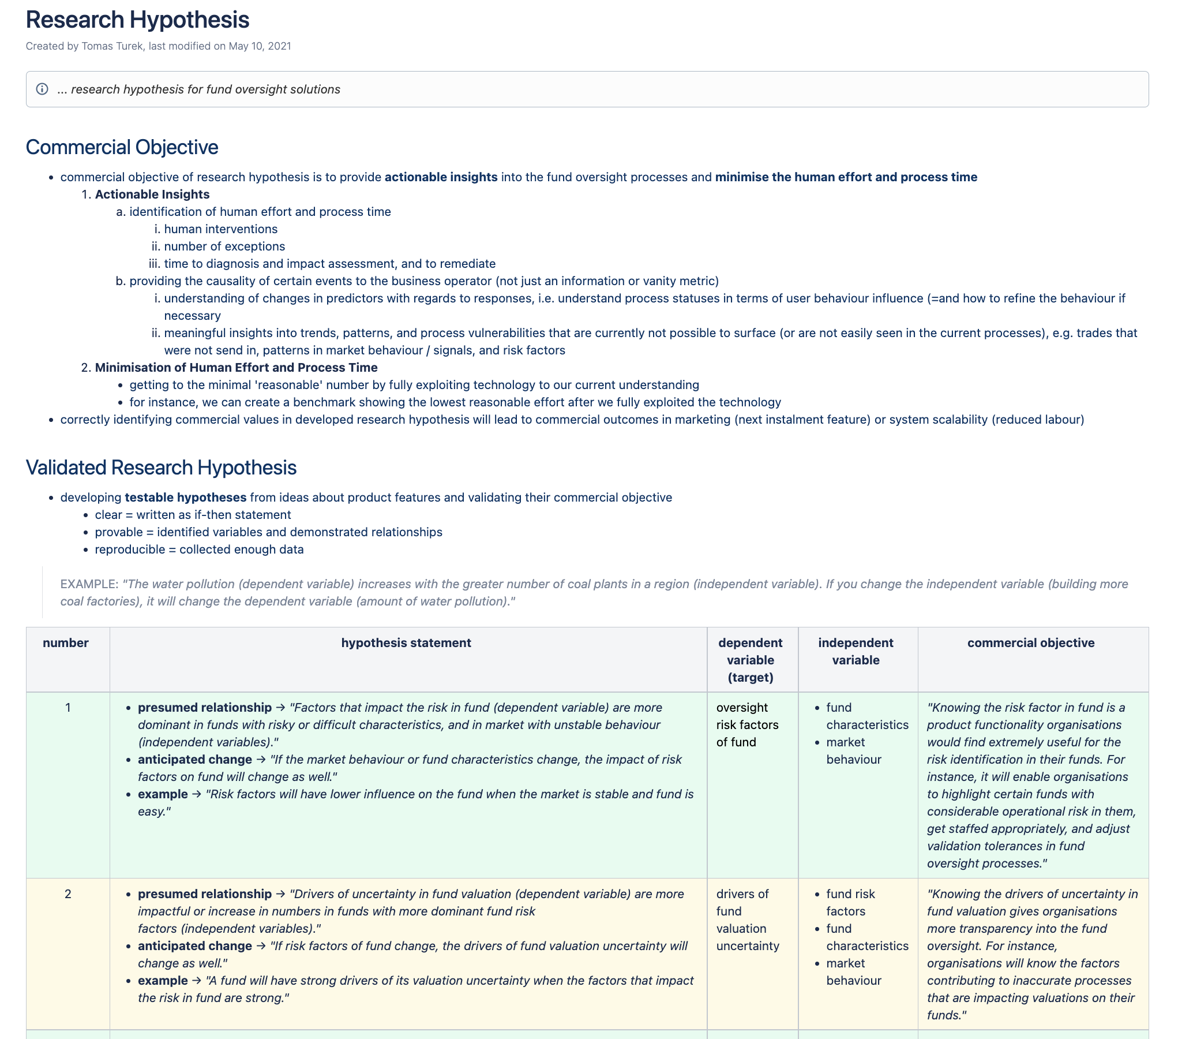
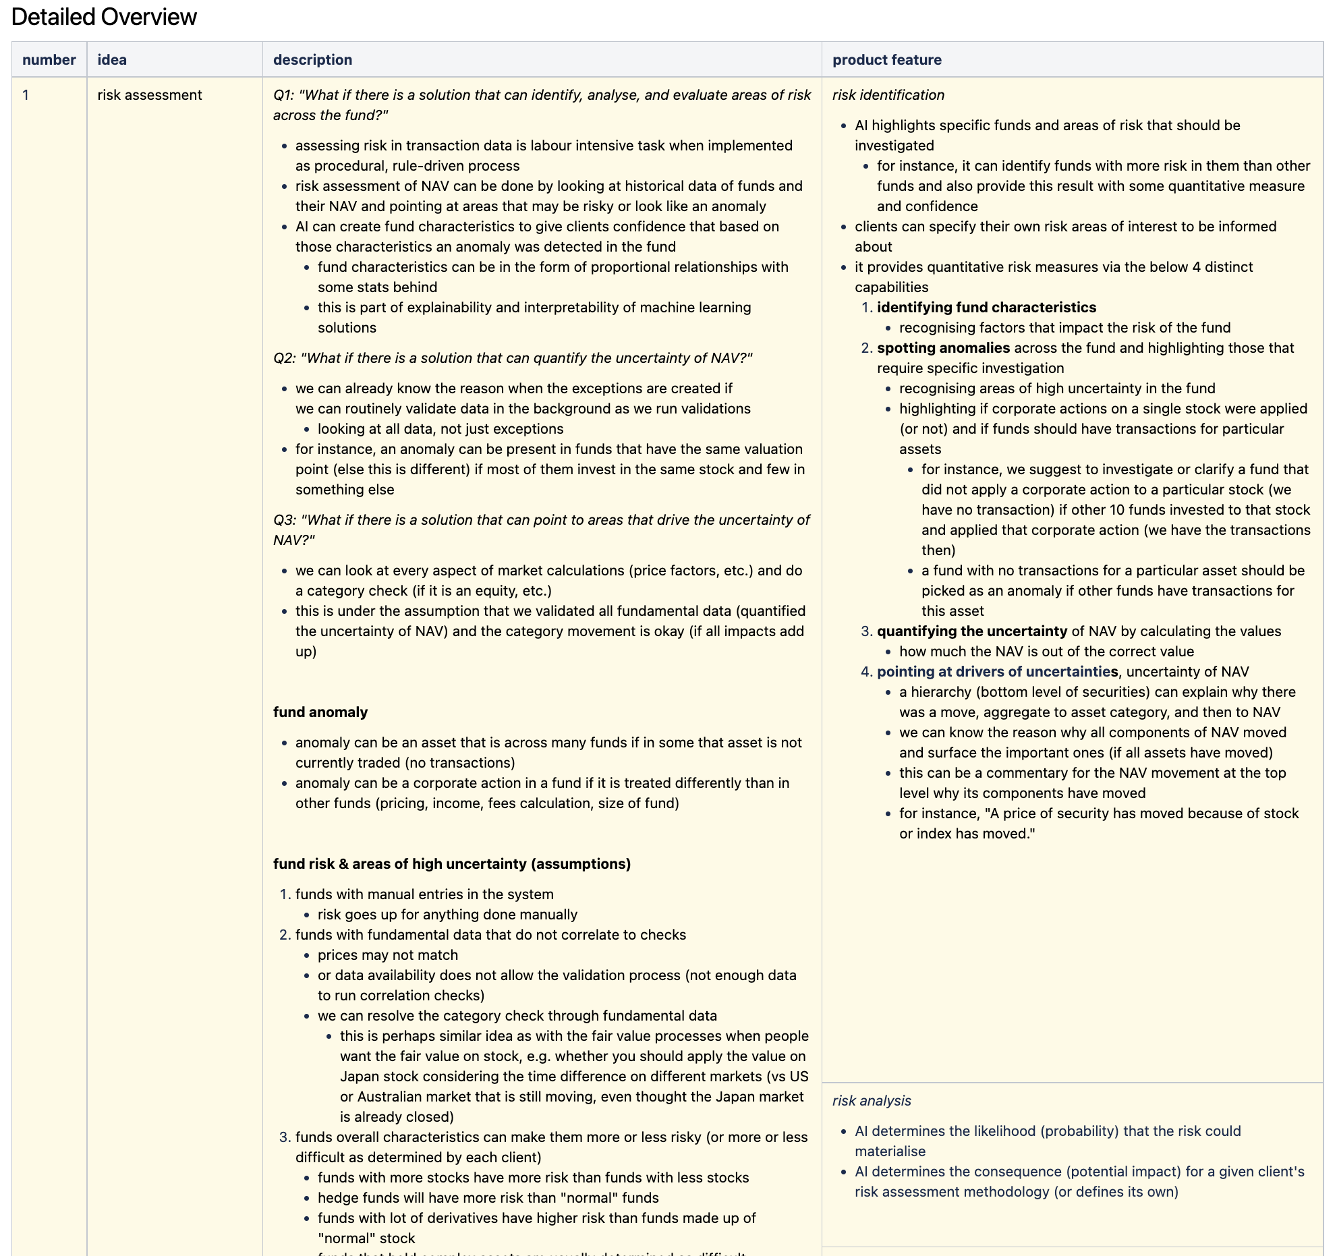
NAV3-POC | Research hypothesis
14 ideas / research hypotheses
Fund risk factors
Drivers of fund valuation uncertainty
Fund valuation confidence
Dynamic tolerances for fund oversight validations
Fund oversight fact-check
Synthetic fund benchmark
Validation-onboarding match for fund oversight
Automated fund narratives
Exception category for pre-fund oversight
Exception management time
Fund pre-oversight confidence
Cognitive oversight of fund
Fund oversight reporting
Fund calendar
http://intranet.milestonegroup.com.au/display/DDS/Research+Hypothesis

Slide 9
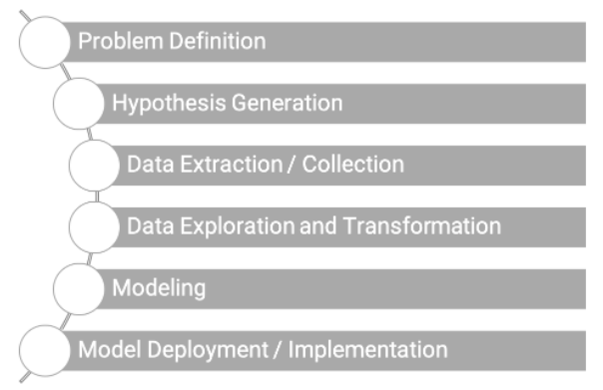

NAV3-POC | Hypothesis generation
Hypothesis is a “guess”
Problem : “I want to predict how heavy traffic will be on a given day.”
Hypothesis : “I think the weather forecast is an informative signal”.

Slide 10
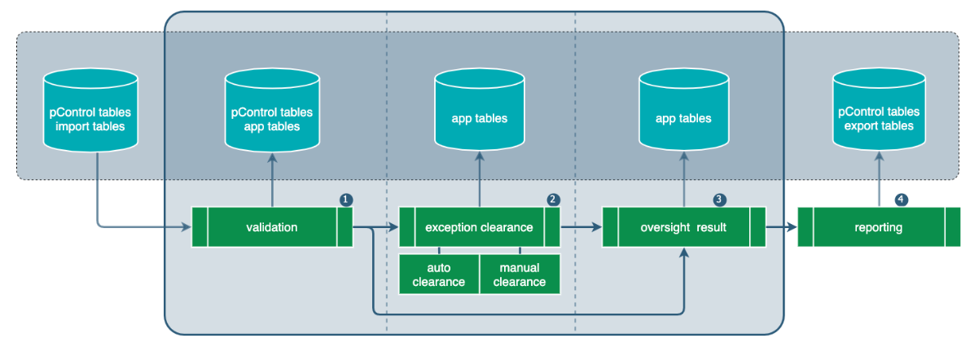
Hypothesis | Dynamic tolerances
(hypothesis : "The tolerances for fund oversight validations are closely align to current market movements.”)

Slide 11
Hypothesis | Dynamic tolerances
(hypothesis : "The tolerances for fund oversight validations are closely align to current market movements.”)
Tolerance(l200)
Market data - Benchmark (u280), Fx rates(u178), Security price(u175), Corporate action(u210)
Validation result – Exception(t330), Validation result(pXXX)

Slide 12
Hypothesis | Dynamic tolerances
(hypothesis : "The tolerances for fund oversight validations are closely align to current market movements.”)
Tolerance(l200)
[BMK004] - Benchmark Movement;
Check Value = 0.54%;
Tolerance Value (at Entity Level DEFAULT) = 0.50%;
Current Value = 7,628.8980;
Previous Value = 7,588.1990;
Value Movement = 0.536346%;
Market data - Benchmark (u280), Fx rates(u178), Security price(u175), Corporate action(u210)
Validation result – Exception(t330), Validation result(pXXX)

Slide 13

Hypothesis | Dynamic tolerances
(hypothesis : "The tolerances for fund oversight validations are closely align to current market movements.”)
goal
We want to update tolerance dynamically.
Validation result
Machine Learning
Rules ??
Market data, tolerance

Slide 14
Hypothesis | Dynamic tolerances
(hypothesis : "The tolerances for fund oversight validations are closely align to current market movements.”)
goal
We want to update tolerance dynamically.
Validation result
Machine Learning
Rules ??
Market data, tolerance
approach
Correlation of fund validation to market movements
Regression – a type of machine learning which helps in finding the relationship between independent and dependent variable

Slide 15

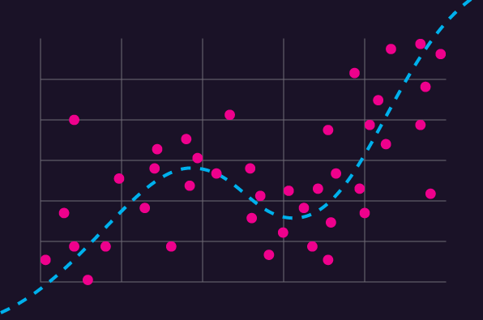
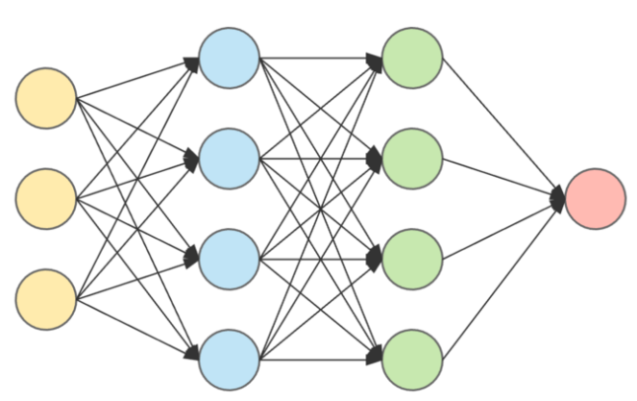


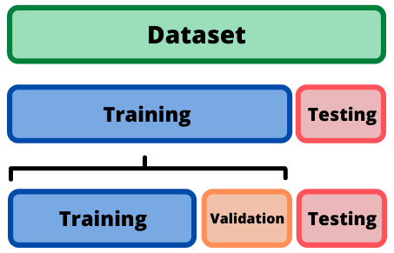
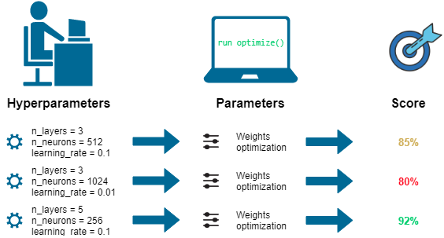
Hypothesis | Dynamic tolerances
(hypothesis : "The tolerances for fund oversight validations are closely align to current market movements.”)
Algorithm selection
Feature selection
Model validation
Model tuning
Notes:
https://scikit-learn.org/stable/tutorial/machine_learning_map/index.html

Slide 16
Hypothesis | Dynamic tolerances
(hypothesis : "The tolerances for fund oversight validations are closely align to current market movements.”)
Model Tuning
Preprocessing
Feature Selection
Training/
Validation Split
Data
Model Training
Algorithm Selection
Model validation

Slide 17
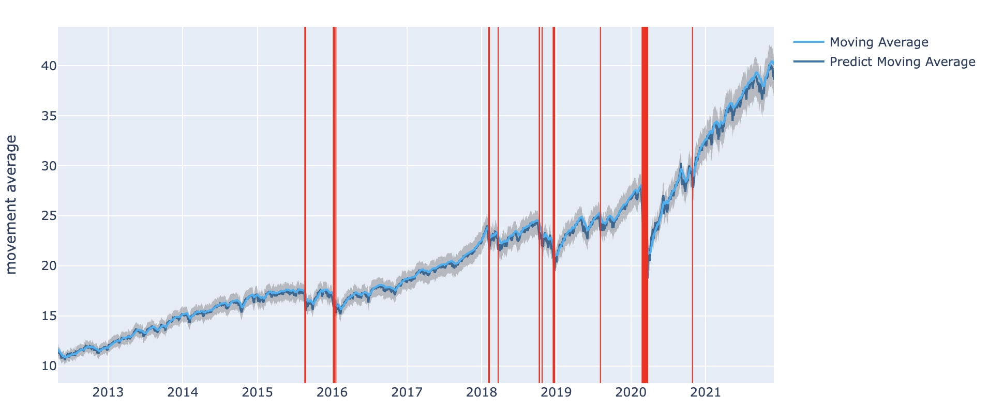
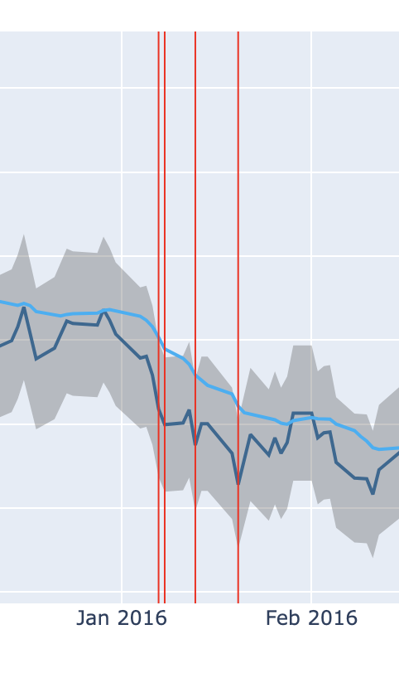
Hypothesis | Dynamic tolerances
(hypothesis : "The tolerances for fund oversight validations are closely align to current market movements.”)
i.e.) breach based on moving average

Slide 18
Hypothesis | Dynamic tolerances
(hypothesis : "The tolerances for fund oversight validations are closely align to current market movements.”)
goal
We want to update tolerance dynamically.
extend
Predict breaches, Auto commentary, Highlight anomaly funds in portfolio
commercial value / user experience
Clients would expect that tolerances go up on volatile day.
Predicting breaches in fund oversight processes gives organisations an indication of the necessary volume of work they need to allocate to the fund oversight.
Organisations will be able to know a complexity of oversight required.
We can look at the market and say that there will be a volatility in market and commodities will be volatile.

Slide 19
NAV3-POC | Progress and challenges
Product ideation
Computational environment
Business development
Product requirements
Product feasibility
Idea creation
Hypothesis generation
Hypothesis validation and prioritisation
Data analysis workflow
Data Governance
Client enrolment
Product data approval
Applied research performance
Experiment requirements
Data analysis
ML-ops vs Dev-ops
the process of automating and productionalising machine learning application and workflows
Data
‘a lot’ of data? Usually thousands of examples for basic model, hundreds of thousands for neural network
Model interpretability
accurate and ‘black-box’ vs weaker and ‘white-box’
More..

